Slide 1
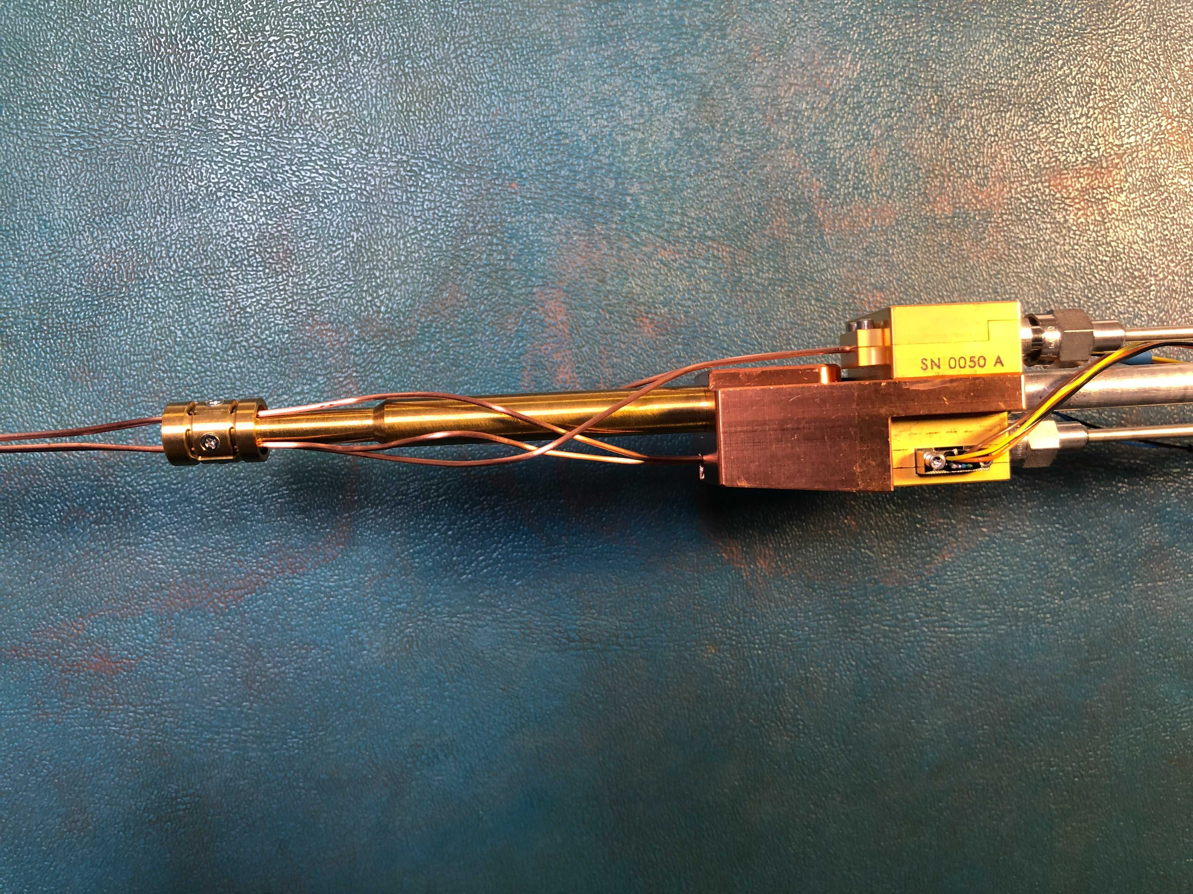
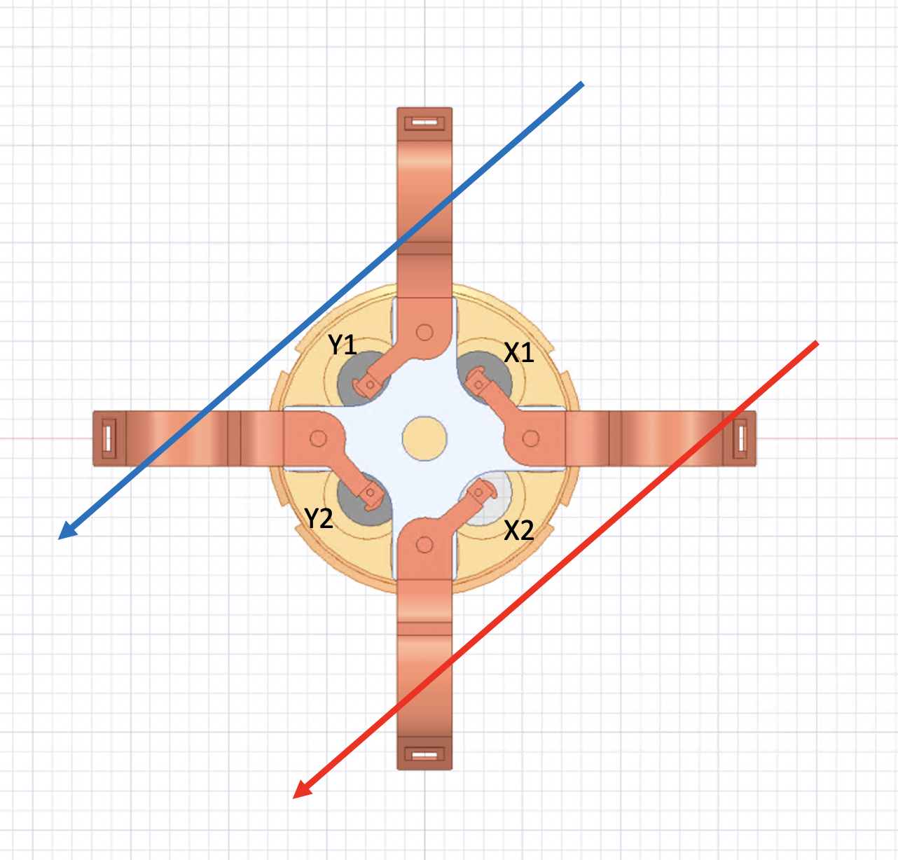
Those two coaxial cables are 90 deg apart and should go to different LNAs
However they are connected to the same LNA, therefore the differential inputs are wrong.

